Slide 1
Failure Analysis after in orbit anomaly on COMEPA bimetallic thermostat TH47
Florian Krimmel
18/10/2024

Slide 2
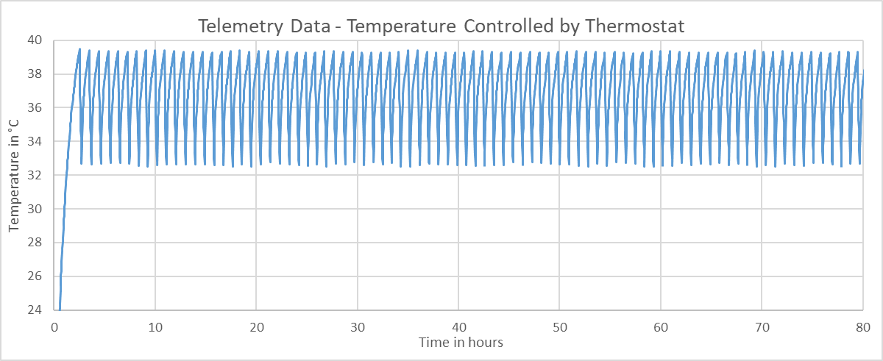
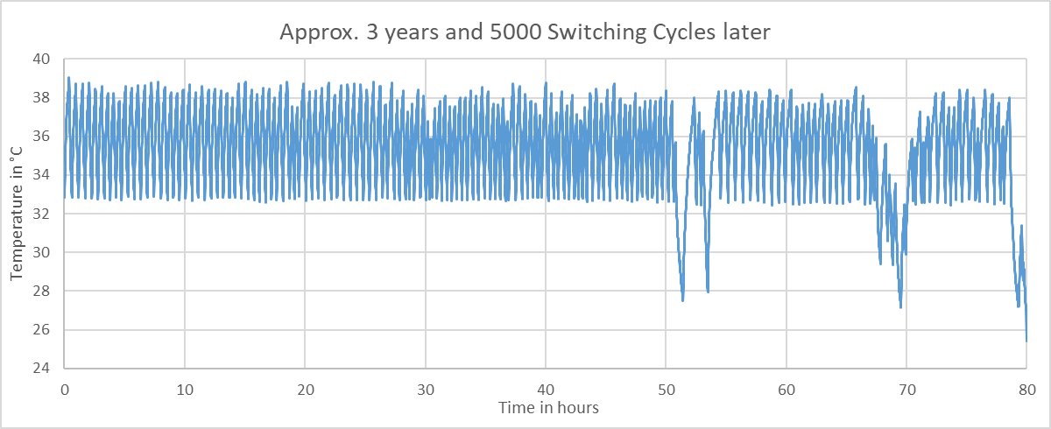
Telemetry Data
Subsystem electrically heated and controlled by thermostat
Required minimum temperature 28ºC
After some time in orbit the first temperature anomaly was observed
After 3 years and 5000 cycles the minimum temperature could no longer be met

Slide 3
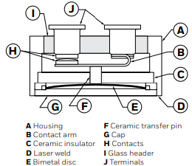
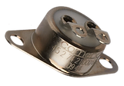
What is a Hermetically Sealed Bimetallic Thermostat Switch?
Source: www.comepa.com/thermostat-division
Source: automation.honeywell.com/3500-series

Slide 4
Component Specification
Part Reference of the component showing this anomaly in flight according to ESCC 3702:
370200101B039034BY Date/Code 1025
restoring temperature of 34ºC
functioning temperature of 39ºC
Lifetime: 100 000 cycles
Closed Contact resistance: ≤ 50 mΩ

Slide 5
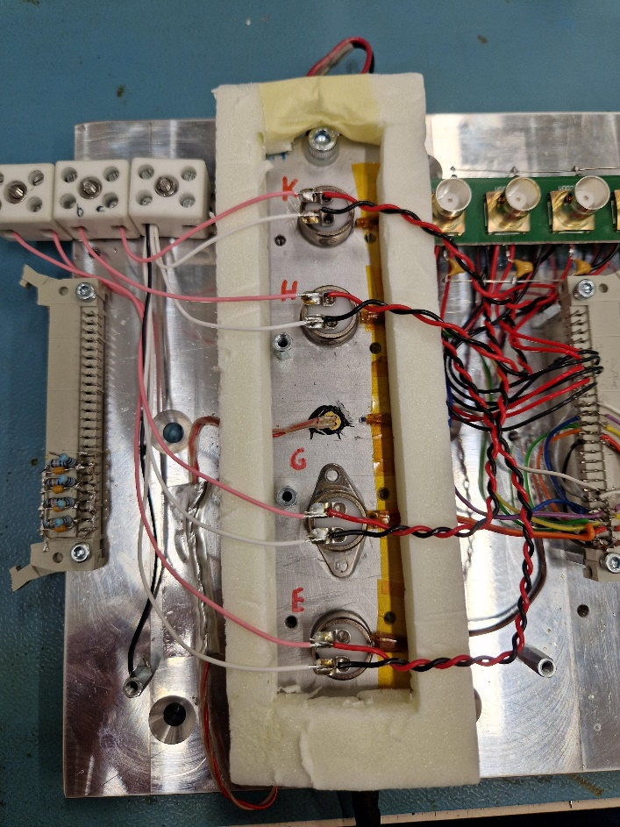
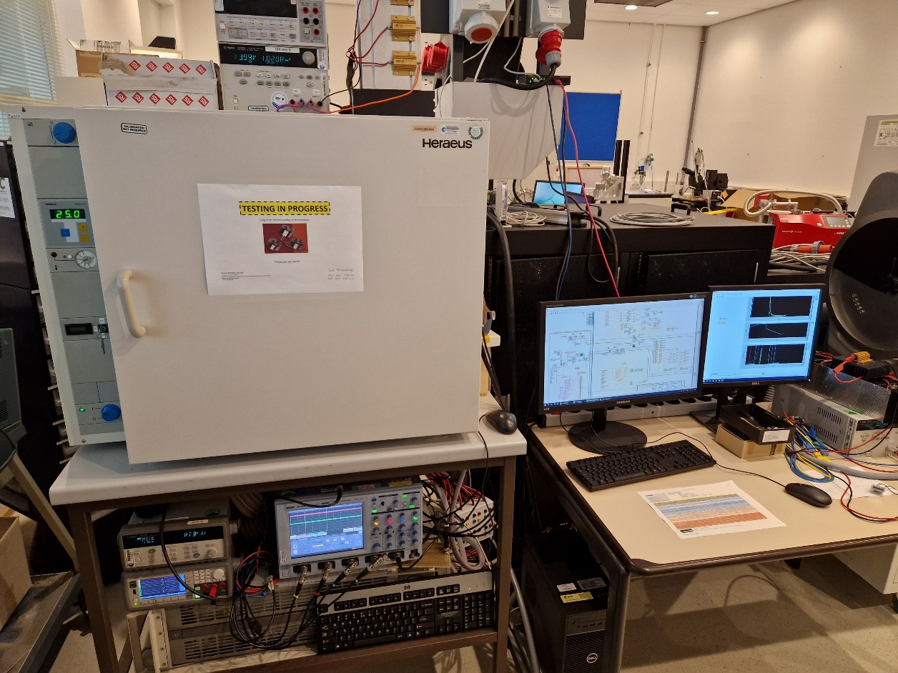
On-Ground Failure Reproduction at the ESTEC EEE Component Labs
THERMOCYCLING TESTING:
DUTs thermally mounted Full test setup in inside a constant temperature oven
on Peltier Elements and with resistive load temperature and voltage measurement

Slide 6
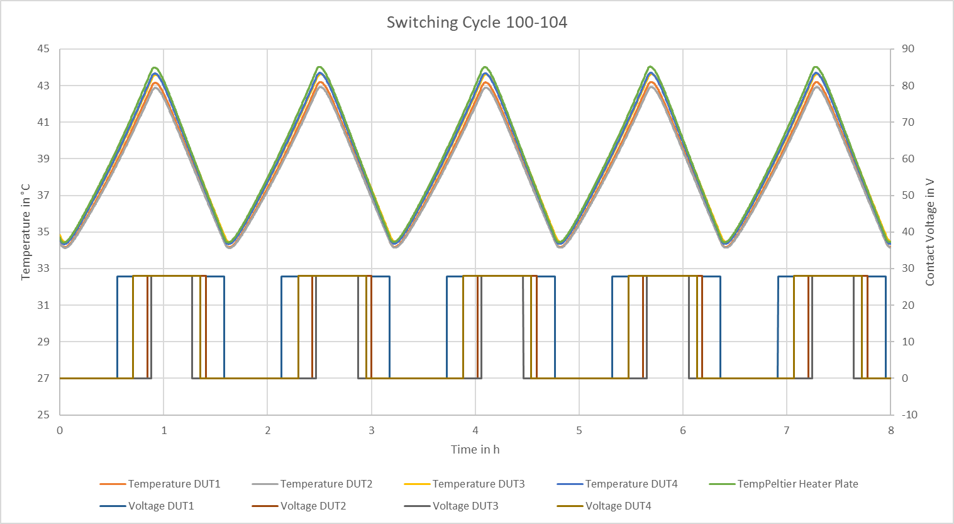
Temperature Profile

Slide 7
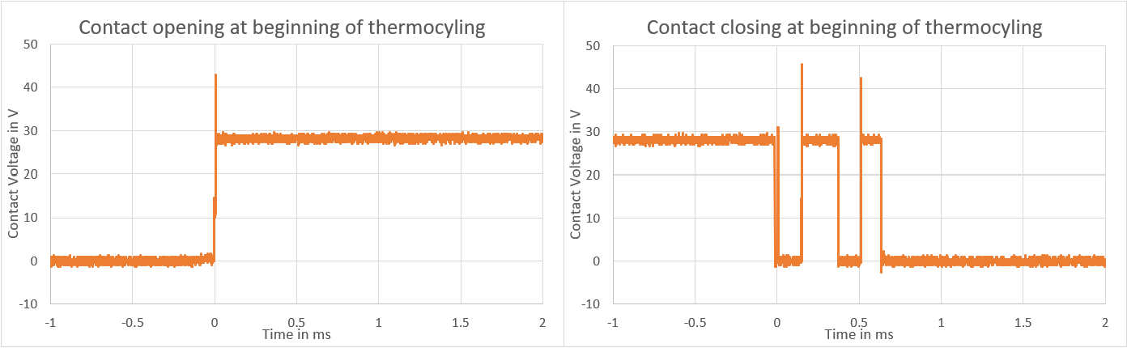
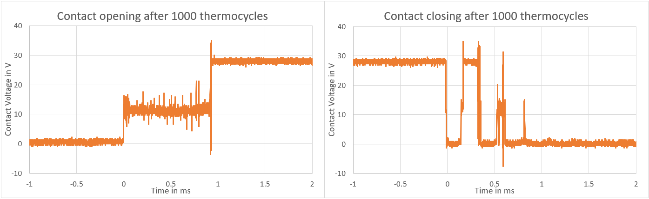
Switching Voltage behaviour change

Slide 8
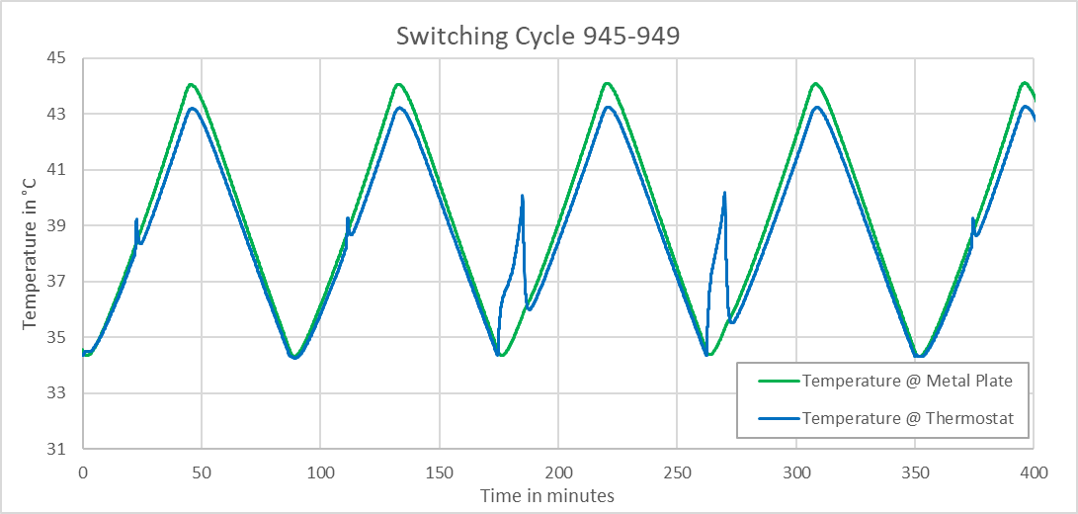
Self-Heating

Slide 9
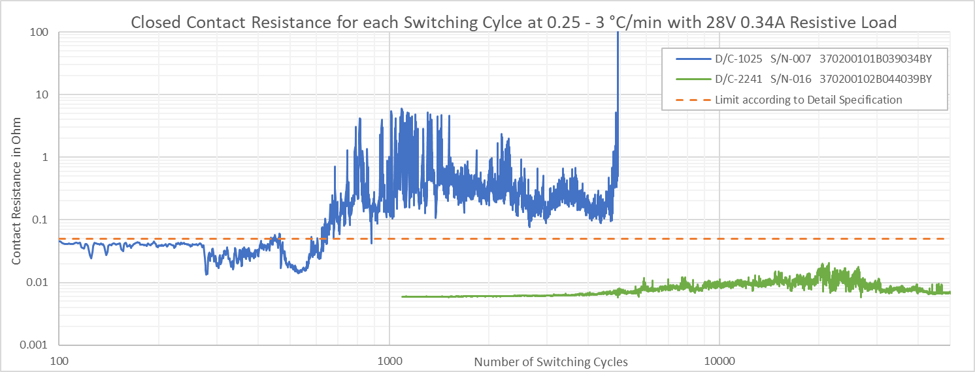
Degradation of Closed Contact Resistance

Slide 10
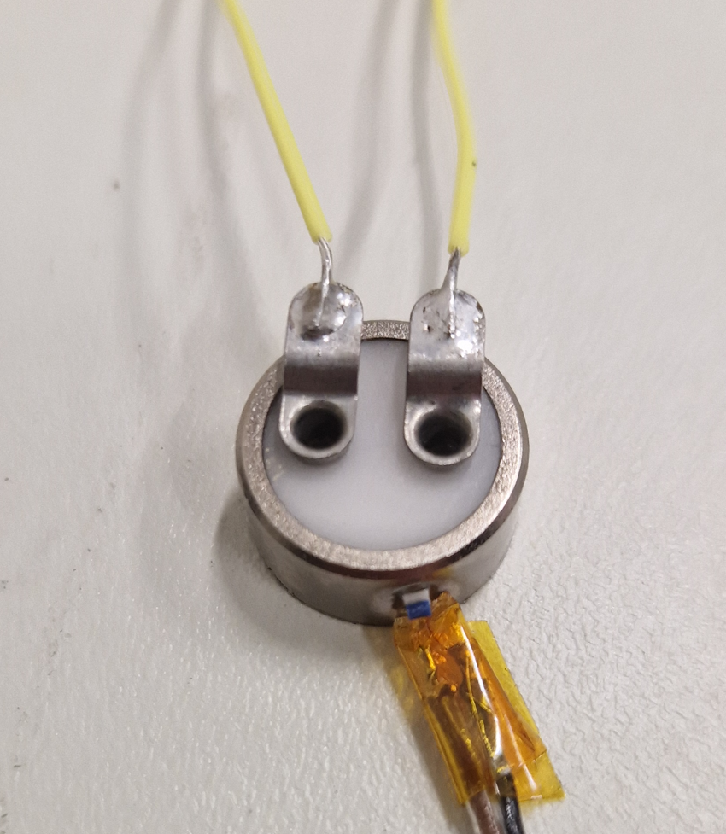
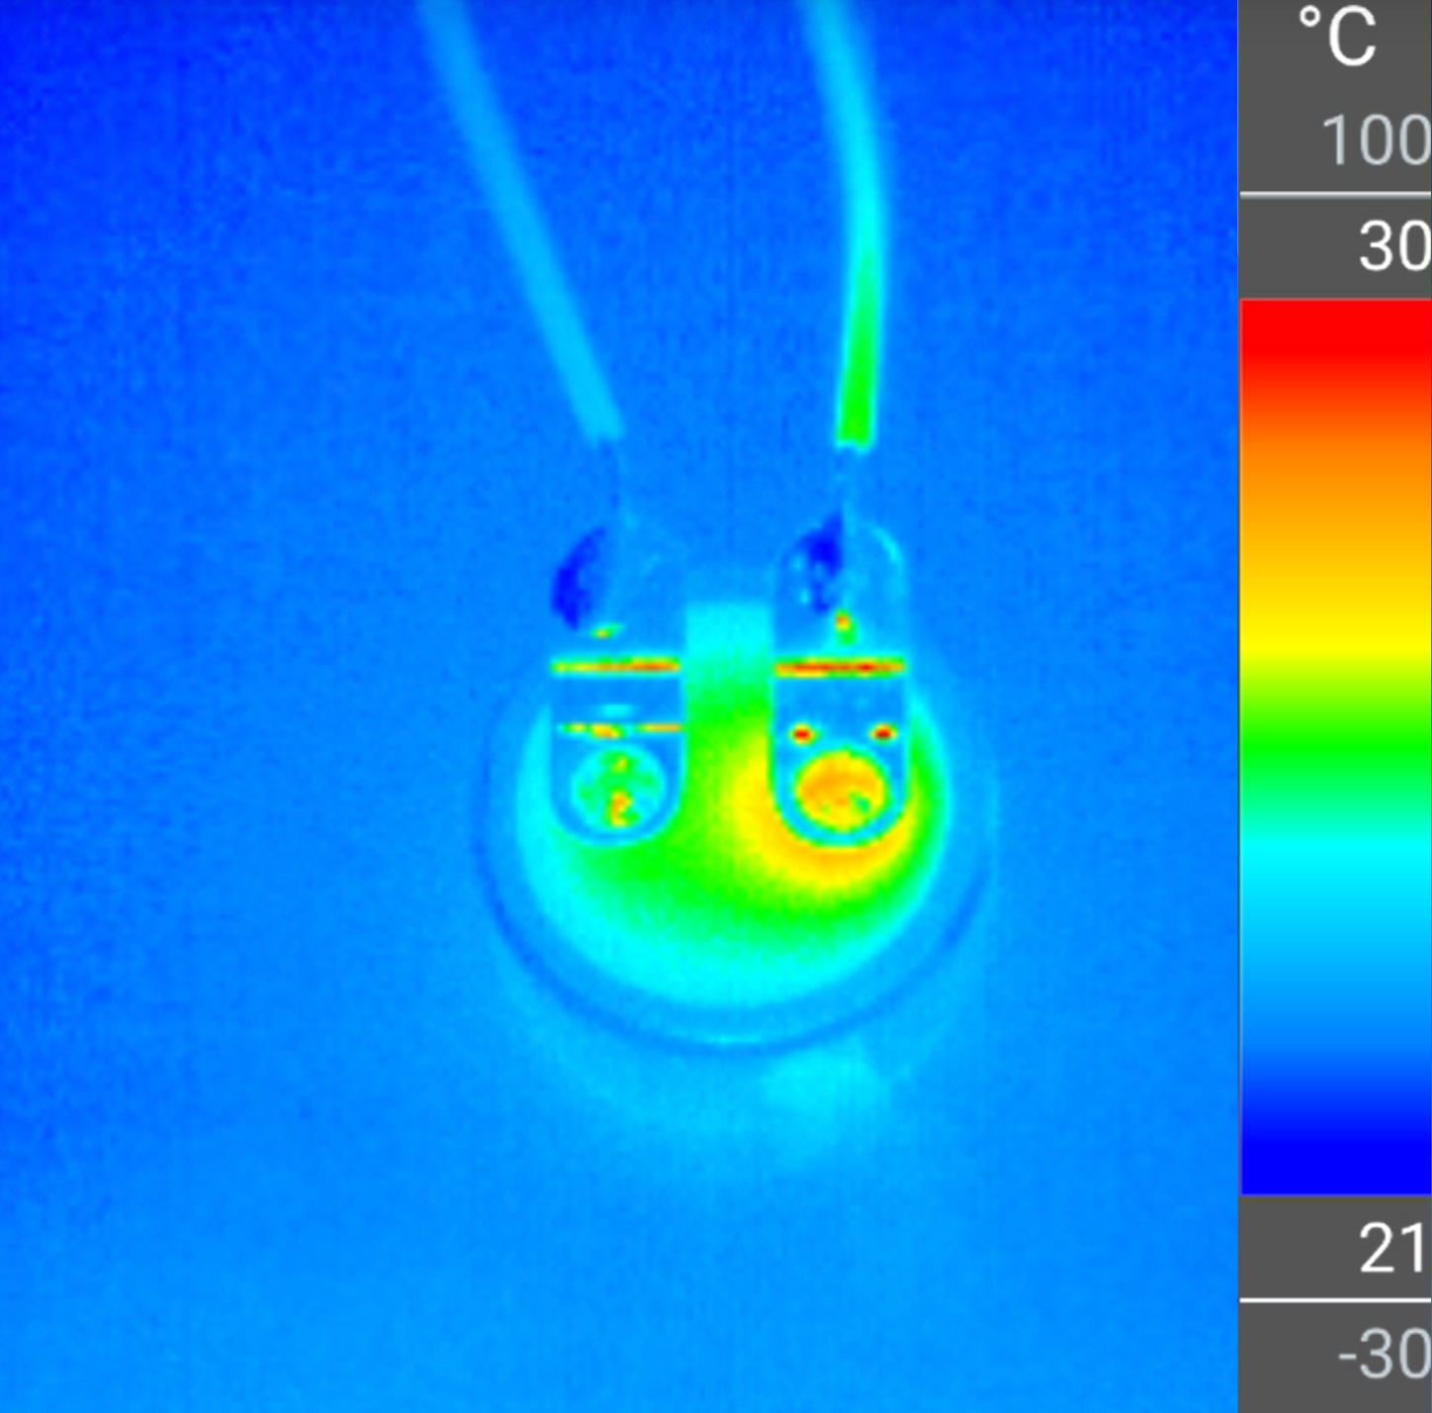
Thermal Image

Slide 11
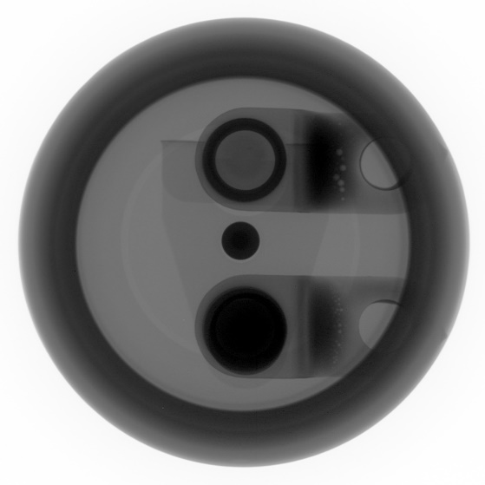
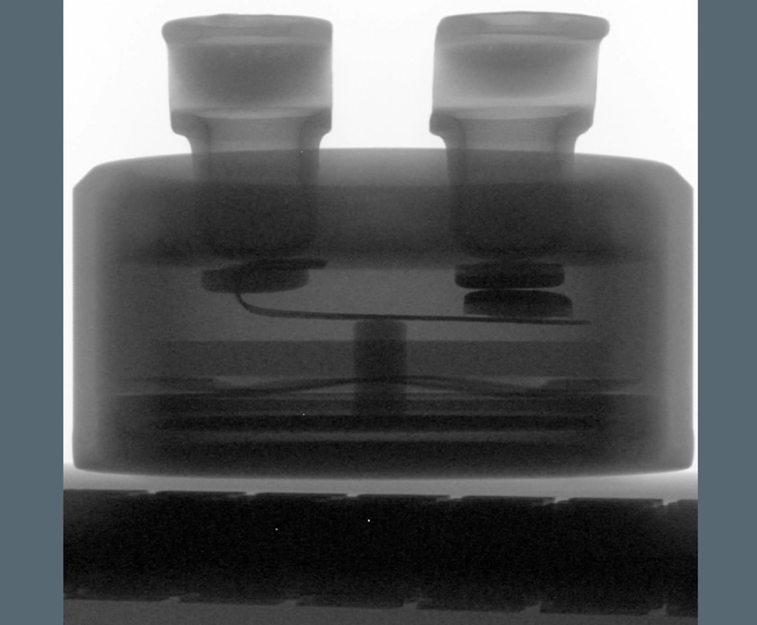
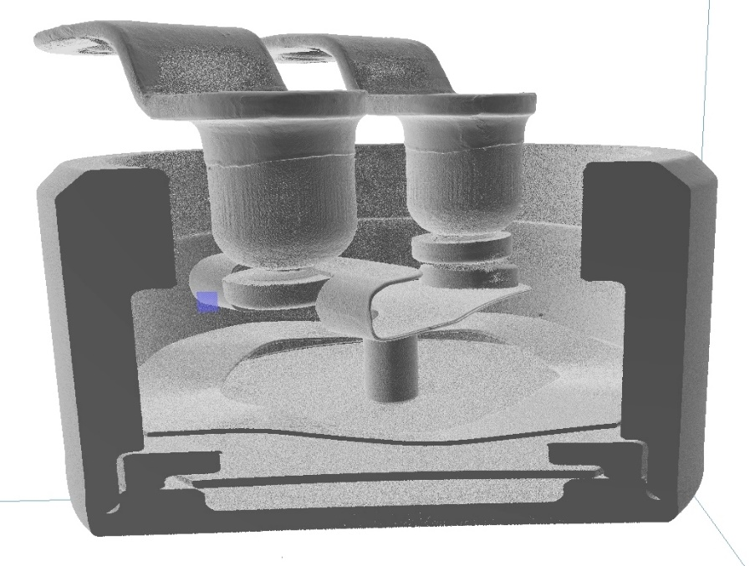
Xray – image and video

Slide 12
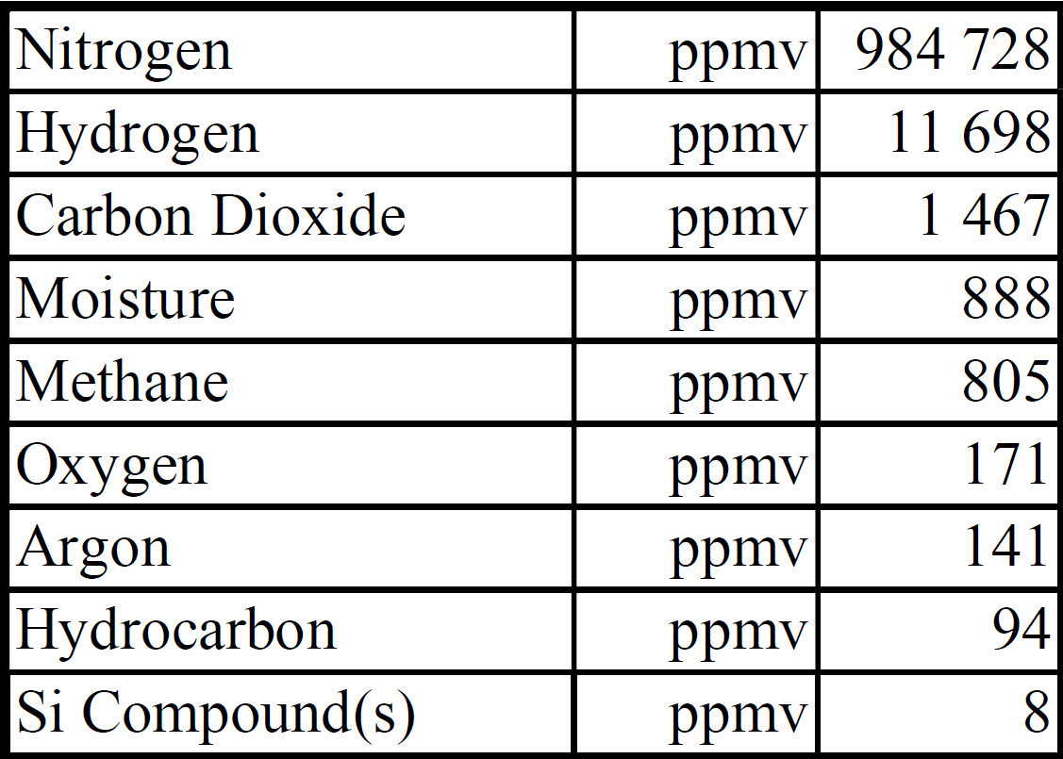

Residual Gas Analysis
Hexamethylcyclotrisiloxane

Slide 13
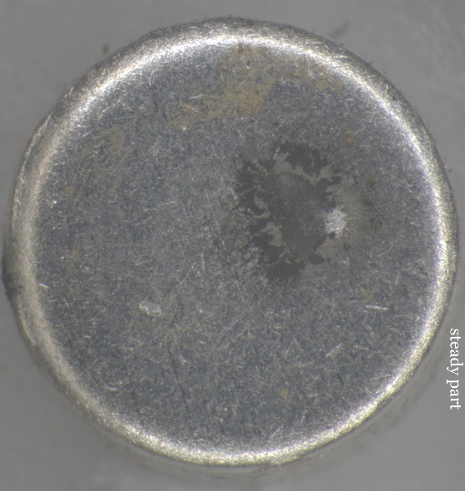
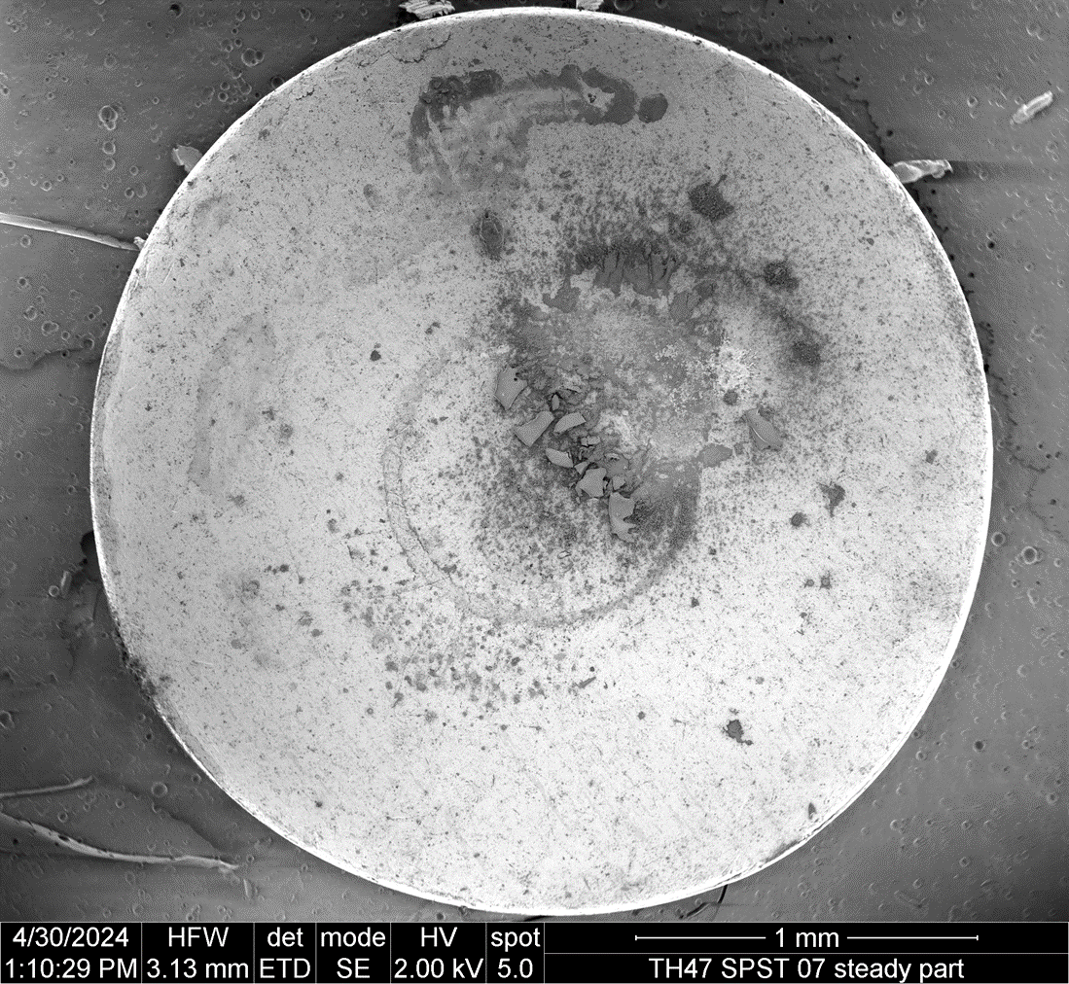
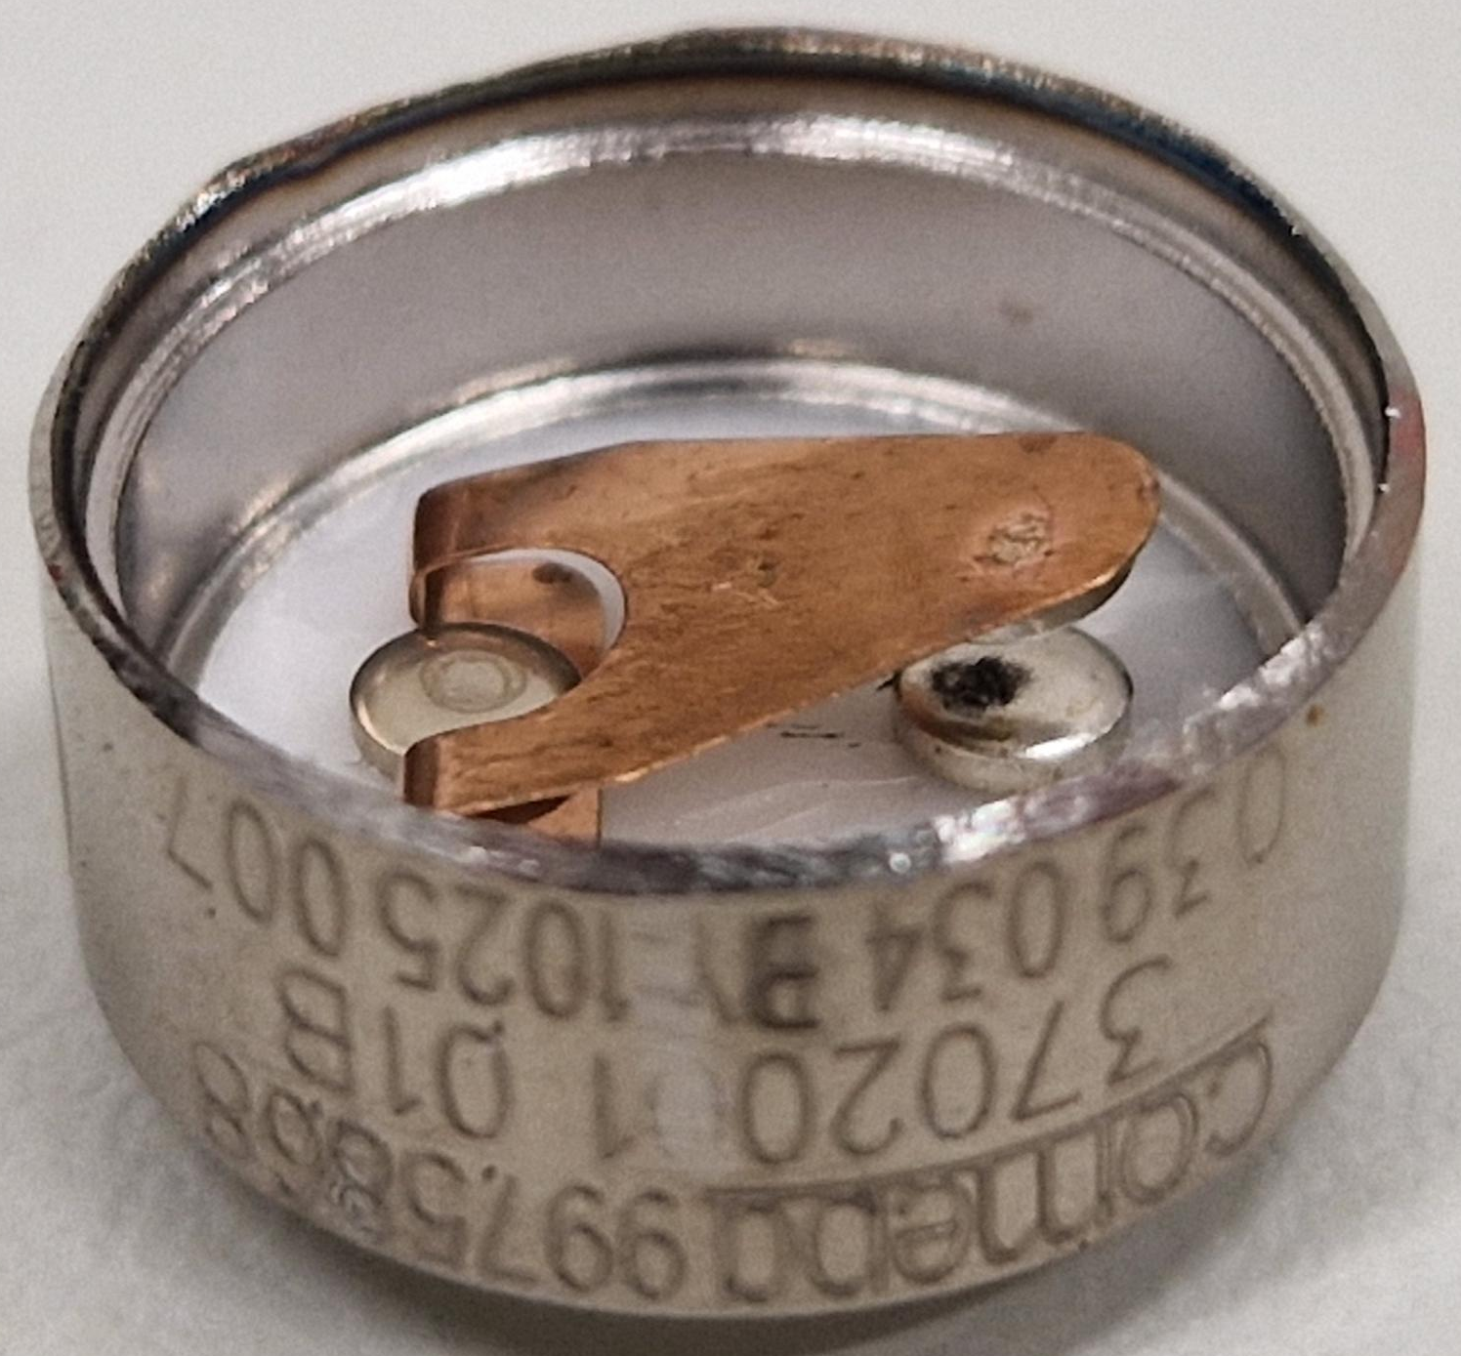
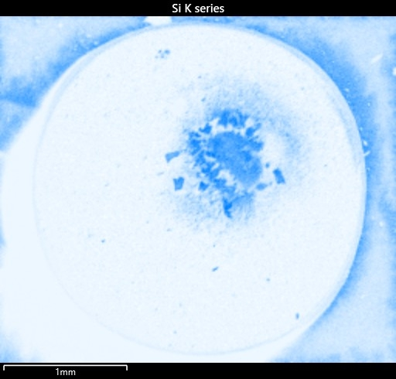
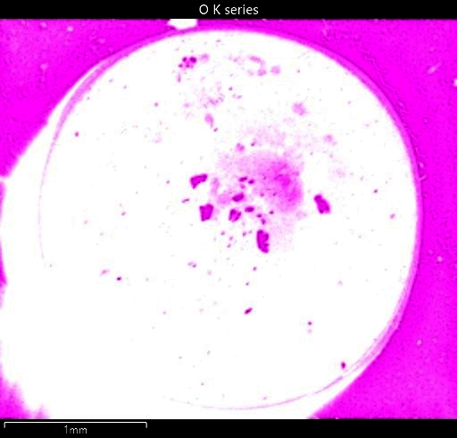
Contact Inspection

Slide 14
Root Cause of Thermostat Failure
Contamination inside the hermetic sealed cavity, together with the electrical arcing on the contacts formed a layer of electrically insulating SiO₂ on the contacts.
The increase of contact resistance generalates heat at the contact.
This heat increases the thermostat temperature by a couple of °C against its sounding
The switching does not happen anymore at the specified temperature
Total failure of the component at around 5.000 cycles
Date codes tested at ESA: 1025, 2241, 2327, 2343
Only date code 1025 showed this failure

Slide 15
Based on the results of the investigation performed at ESA’s EEE Component Laboratory the failure mechanism is fully understood now
What can we do to avoid an impact on the in-flight operations by the upcoming failure of the thermostats?

Slide 16
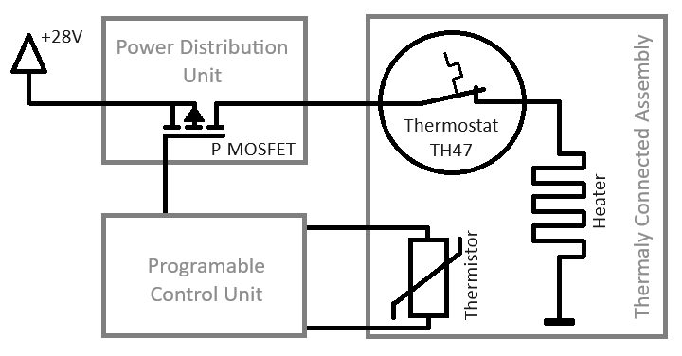
Approach to mitigate the in-orbit anomaly
Avoiding further degradation of the thermostat
by operating it only at temperatures where the contact stays always closed
and controlling the temperature at the target by using the Telemetry Thermistor and the Power Distribution MOSFET

Slide 17
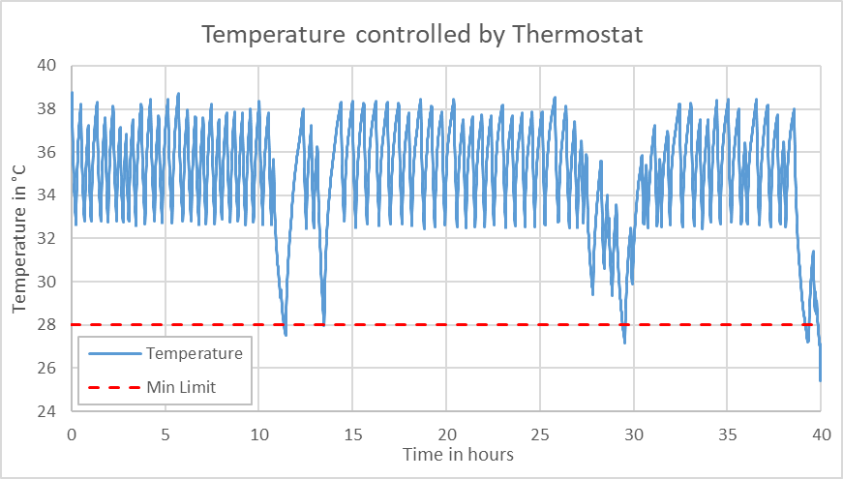
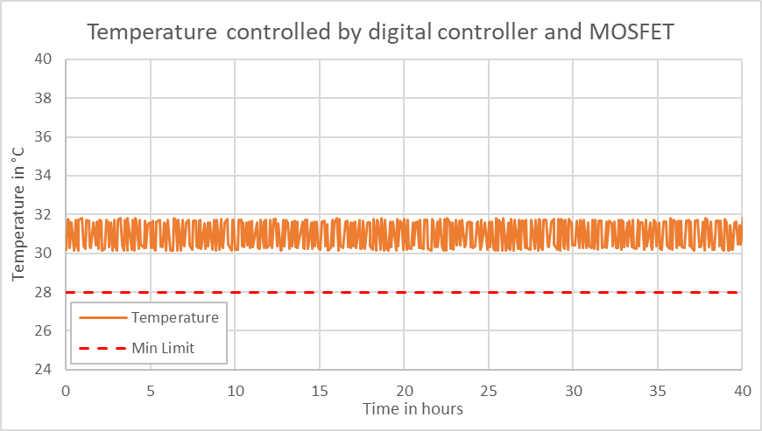
Telemetry data after implementing new control loop

Slide 18
Thank you for your attention!
Visit our website if you want to learn more about
ESAs Material and Electrical Components Laboratory:
https://technology.esa.int/lab/materials-electrical-components-laboratory

